Slide 1
Protecting Our Rivers With Stormwater Management
Camden County
Shalana McNamee, Director, Public Works
Certified Stormwater, Erosion, and Sediment Control Inspector (FL)
Level 1A Erosion & Sediment Control (GA)

Slide 2
Stormwater Management Article 11
Proper management of stormwater runoff is critical to protect our public, environment, water, and aquatic resources.
125 miles of unpaved roads in the unincorporated area (42%)
Sediment & NPS Pollution from our unpaved roads is a high priority
Camden County has several practices in place and we continue to add new tools and resources to help protect our waters.
Ordinances, Permits, and Regulations (New Construction & Maintenance)
Code Enforcement
Erosion and Sediment Control (Previously presented by Scott Brazell)
Better Back Roads BMP’s for maintaining unpaved roads
Additional Projects

Slide 3
Ordinances, Permits, Regulations
It is the intent of this Development Code that this Division be consistent with the Georgia Stormwater Management Manual and any supplement adopted to said manual regarding stormwater management in the Coastal area. All references herein to the Georgia Stormwater Management Manual shall be interpreted to include any such supplement for the Coastal area.
Camden County Unified Development Codes which regulate following:
Illicit – non – stormwater discharges and illegal connections
Maintenance of existing stormwater facilities
Stormwater management
Drainage system construction
Stormwater collection and discharge
Catch basins and storm sewer structures
Construction and ground water
UDC Codes for Camden County Can be found on our County Webpage. Private, commercial, residential, developers or any person building or constructing within the county have to apply and follow all permit requirements and our UDC codes.

Slide 4
Ordinances, Permits, Regulations
Motor Grader Operators are trained using the Better Back Roads manual. Our team was very involved with writing the updated version.
Stormwater drainage and stormwater management ordinance Article 11, Division 2, sec 1109 – Camden County UDC
Stormwater permits : All persons proposing development and/or construction in Camden County shall submit a stormwater management plan to the county for approval. This plan shall comply with the requirements set forth in Sec. 1114(c) below. All development and/or construction within Camden County shall meet requirements of the Georgia Stormwater Management Manual, Vol. 2, unless otherwise specified in this Division.
Land Disturbance Permits
Erosion and Sediment plan requirements/Permitting
Forestry Permits
ROW Permit for culverts/cross pipes

Slide 5
Code Enforcement Department
Code Enforcement and Inspections conducted by County Agents to uphold Camden County UDC Codes.
Inspections and enforcement for violators
Missing Permits
Violating Ordinances
Litter and Debris
Violations, enforcement and penalties Article 11 Division 2 Section 1115
Inspection and Enforcement for Erosion and Sediment Control (Camden County UDC)
Article 11 Division 1 Section 1105 Inspection and enforcement
Article 11 Division 1 Section 1106 Penalties

Slide 6
Additional County Projects
319 (h) Grant – Horsepen Creek Septic Tank Replacement 2018-2021
Over time, the 2018 monthly mean bacterial counts dropped 92%. This result proved the effectiveness of the program and justified further maintenance and operations mea­sures.
Currently in Phase 3
Currently working on test pilots to improve unpaved roads to reduce sediment run off.
319 (h) Grant application – Nonpoint Source Implementation Grant
GOAL: Reduce the nonpoint sources of pollution (specifically on sediment from our unpaved roads) to our watershed by implementing BMP’s to our unpaved roads and substantially reducing sediment run off into the stormwater drainage ditches, wetlands, and ultimately into the White Oak Creek-Satilla River Watershed.
Install geosynthetics and aggregate to keep sediment from going into stormwater drains.
Grass stormwater drains to help reduce pollutant runoff

Slide 7
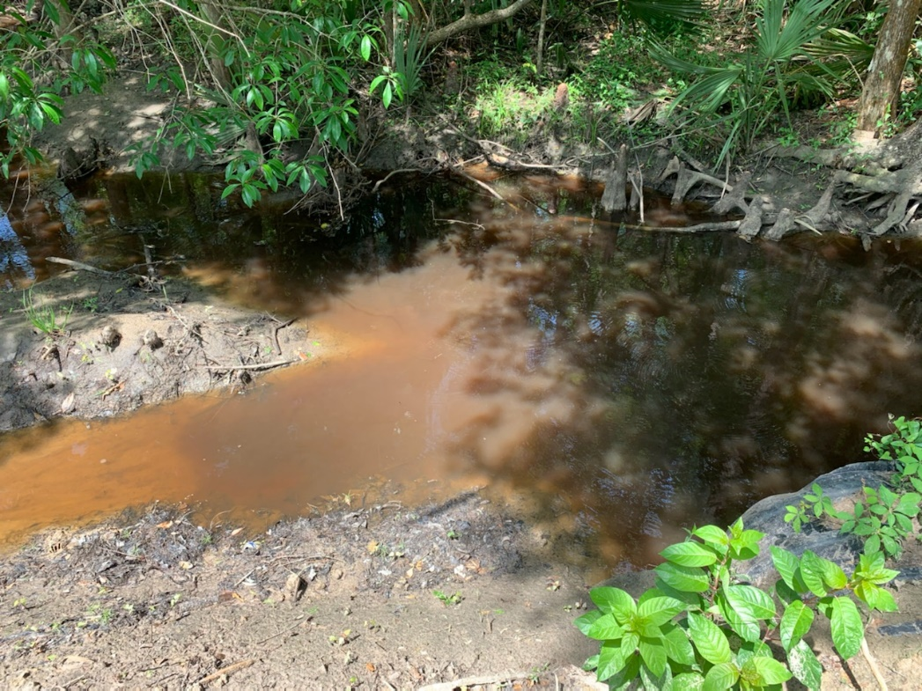
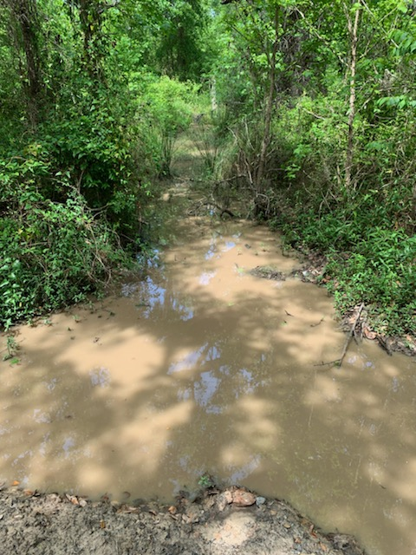
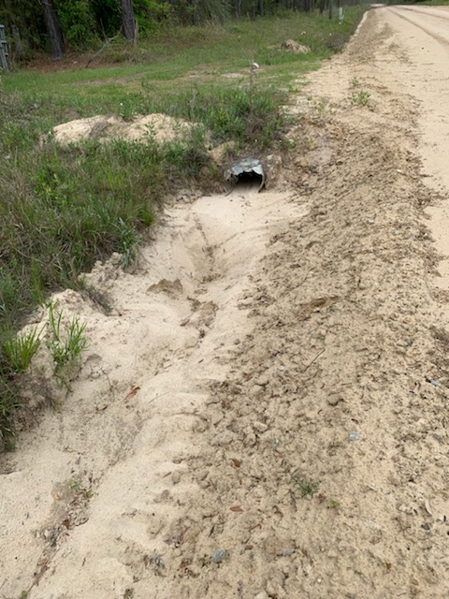
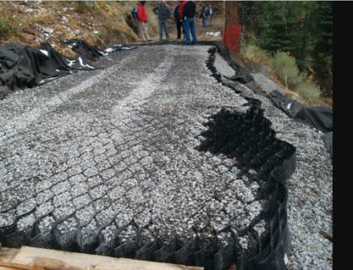

Slide 8
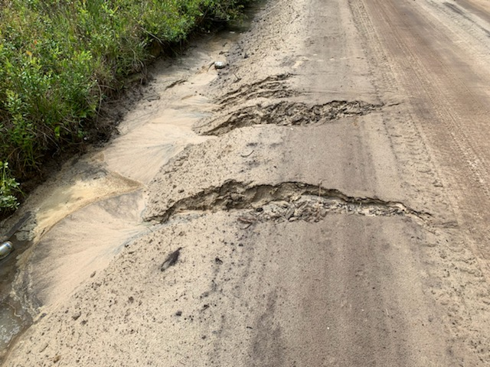
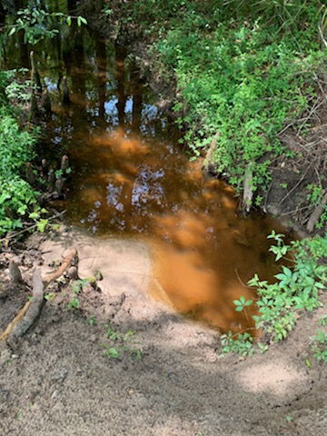
Keeping non point source pollution including sediment out of our state waters is the ultimate goal of the program. 22% of freshwater fish species, 28% of mollusks, and 36% of crayfishes are imperiled in Georgia because of sediment and other contaminates. * Credit Scott Brazell

