Slide 1
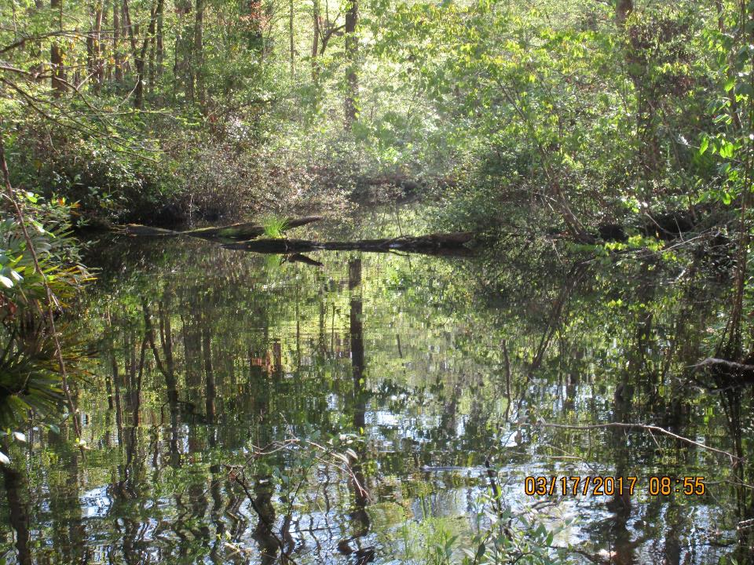
Nassau County, Florida BOCC
Engineering Services
Stormwater Program
Katie Peay, PE CFM | Sr. Stormwater Engineer
Nassau County|Engineering Services
96161 Nassau Place|Yulee, FL 32097
P: (904) 530-6225 E: kpeay@nassaucountyfl.com

Slide 2
What Nassau County Had:

Slide 4
Process for Drainage Complaints
Construction Inspector Reviewed site
Memo created
No documentation of resolution

Slide 5
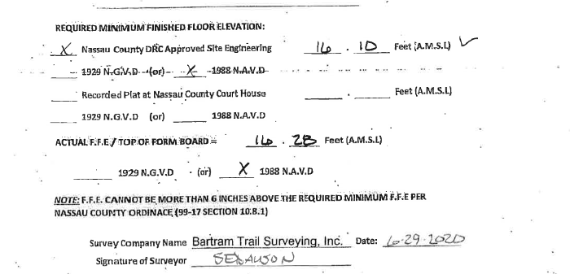
Formboard Elevations

Slide 6
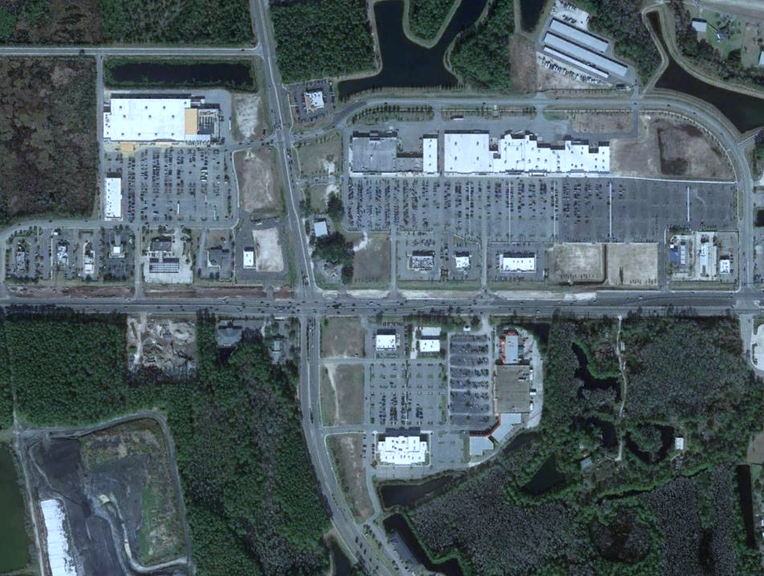
Nassau County, Florida BOCC
Engineering Services
Ordinance 99-17
Roadway and Drainage Standards
January 27, 2020
Nassau County|Engineering Services
96161 Nassau Place|Yulee, FL 32097
P: (904) 530-6225 E: rcompanion@nassaucountyfl.com

Slide 7
Process for Recommending Updates
Lot Grading Regulations
Two Advisory Committee Meetings
Advisory Committee Members
County Stormwater Engineer
City Stormwater Engineer
Four Private Sector Engineers
County Planner / CRS Coordinator
All recommended updates approved by all Advisory Committee Members

Slide 8
Lot Grading Regulations
Current Issue | Section(s) | Desired Outcome | Proposed Updates / Language
Finished floor elevation (FFE) requirements are dictated by road elevation on larger parcels, may require property owners to bring in excessive fill | 10.8.3 10.8.4 | Provide some flexibility for approval of FFE changes on the engineering staff level when appropriate. | 10.8.3. If no drainage plan exists, or if the plan predates this chapter, the floor level shall be at least eighteen (18) inches above the centerline roadway. This floor level requirement may be reduced on lots greater than one (1) acre, if approved by engineering services. The maximum floor elevation shall not exceed six (6) inches more than specified in the engineer of record’s county approved drainage plan on lots less than one acre.
There are currently no requirements for single family dwellings to consider stormwater runoff and the effects said runoff will have on neighboring parcels. Many issues have been noted on, Amelia Island specifically, related to excessive fill being brought in on new home sites. Runoff concerns, complaints, and litigation has occurred as a result of this issue. | 10.8.9. | Lot grading will be planned by a design professional, and all runoff will be required to be treated on site if there is not master drainage plan already in place. If a stormwater system is already engineered (as in most subdivisions), these requirements will not apply. | Section 10.8.9 added
There are currently no County regulations regarding illicit discharges into stormwater treatment systems. We have little to no recourse for enforcement or cleanup. We are encouraged by DEP to add language in our code to address. Once we reach the requirements for MS4 we will be required to add this language. | 10.9 | Utilize DEPs standard language to address illicit discharges into stormwater systems allowing for enforcement. | Section 10.9 added

Slide 9
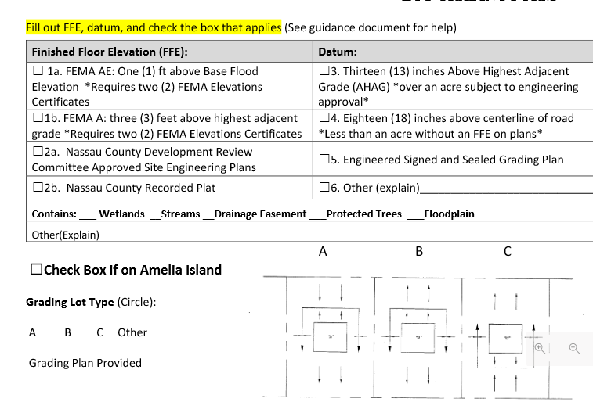
Lot Grading Regulations

Slide 10
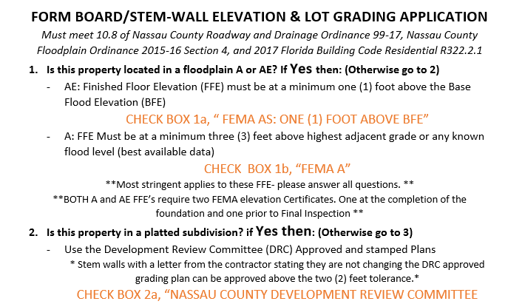
Lot Grading Regulations

Slide 11
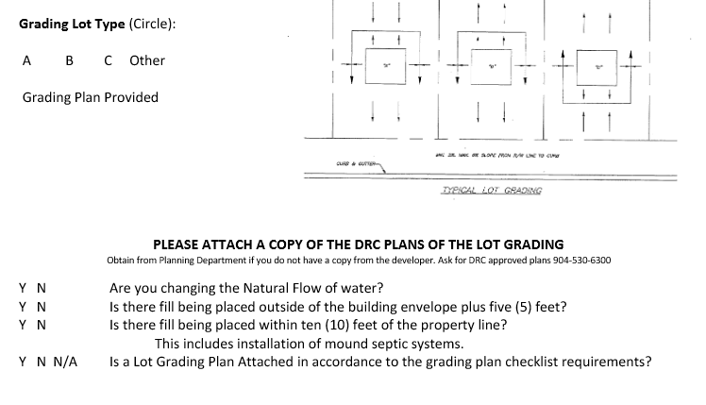
Lot Grading Regulations

Slide 12
Lot Grading Regulations
10.8.9. Stormwater, Drainage, Storage and Treatment Requirements for Single Family Dwellings
The terms and provisions of this section shall apply as specified herein to all developments and redevelopments, and government agencies located within the unincorporated areas of Amelia Island.
An applicant shall be required to provide onsite storage of stormwater for all development and redevelopment projects not part of a subdivision with a designed stormwater system and for any addition or modification that increases the impervious surface area on a developed lot by more than 20%.
Projects located outside of a subdivision, but in an area with an available engineered stormwater system shall ensure that stormwater is properly routed to the stormwater structures.
Any modification or replacement of driveway and sidewalk areas on a developed lot shall not require onsite storage improvements provided the modification or replacement does increase the impervious area of the existing driveway or sidewalk area.
Where possible, utilize low impact development (LID) techniques such as rainwater harvesting, roof downspout disconnection, rain gardens, green roofs, trenches and chambers, bioretention, vegetated filter strips, permeable pavement, enhanced grass swales, dry swales, and perforated pipe systems. These systems will need to be in a recorded maintenance agreement to follow the deed on the lot .
All lots and development sites shall be constructed and graded in such a manner that the stormwater drains to the adjacent street, an existing natural element used to convey stormwater, or county drainage structure after meeting onsite storage requirements.
Except as required to meet coastal construction codes as set forth within a valid permit from the Florida Department of Environmental Protection; or as required to meet applicable flood zone or stormwater regulations as set forth herein, the elevation of a development or redevelopment site shall not be altered without an engineered stormwater design approved by Engineering Services.
An as-built approved by Nassau County Engineering Services shall be provided before issuance of final certificate of occupancy including any lot grading.
Volume calculations for any projects that require onsite storage shall be based on the following calculation:
V = CAR/12, where
V = volume of storage in cubic feet,
A = total impervious area,
R = mean annual rain event
C = runoff coefficient is 0.92, the difference between impervious area (C = 1.0) and undeveloped conditions (C = 0.08).
This volume must be stored at least one (1) foot above the wet season water table and below the overflow point to offsite (in many cases this may be the adjacent road elevation). As an option, and as approved by Nassau County Engineering Services, an applicant may implement, at the applicant's cost, offsite storage and necessary conveyance to control existing flood stages offsite., provided documentation showing appropriate authorization for the off-site use and meeting the requirements of this section is submitted and approved by the county

Slide 13
Lot Grading Regulations
There shall be no net loss of storage for areas in a Special Flood Hazard Area and Shaded X zones. Site grading shall create storage onsite to mitigate for filling of volume onsite. This storage is in addition to the storage required for the increase in impervious surface area. The applicant shall provide signed and sealed engineering plans and calculations documenting that this "no net loss" requirement is met.
This excludes fill brought in for STEM wall stabilization.
Engineering Services shall have the right to exempt any project from the no net loss requirements which borders on and discharges directly into tidally influences bodies of water
Subsequent to approval of a property owner's final grading, including onsite and/or floodplain storage and stormwater treatment and closeout of the applicable permit or issuance of certificates of occupancy, the improvements shall be maintained by the property owner and recorded in a maintenance agreement.
In order to ensure compliance with the provisions of this section and the requirements to maintain onsite stormwater improvements over time, the County is authorized to conduct inspections of property, upon reasonable notice and at reasonable times, for the purpose of inspecting said property and/or onsite storage improvements for compliance with this section and with any applicable conditions of previously issued permits.
Failure to maintain the improvements will require restoration upon notification by engineering service or code enforcement, within a stipulated time frame.
If restoration is not completed within Nassau County’s Code requirements, the county shall have the right to complete the restoration, and the county's actual cost incurred, together with a charge of one hundred (100) percent of said costs to cover the county's administrative expenses, shall be charged to the then owner of the property.
Applicants shall provide documents and calculations to demonstrate compliance. The submittal of application for construction shall be completed by an engineer.
Impervious surface requirements shall not be eligible for relief via waivers from the Planning and Zoning Board.

Slide 14
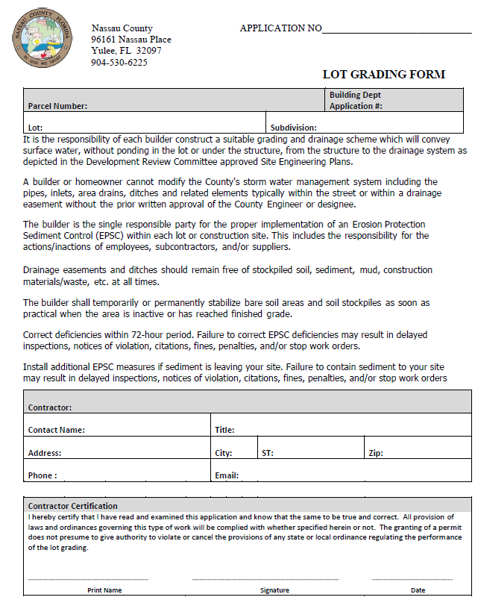

Slide 16
Lot Grading Regulations
10.9 Illicit Discharge and Connection
10.9.1. Purpose
The purpose of this article is to provide for the health, safety, and general welfare of the citizens of the County of Nassau through the regulation of non-stormwater discharges to the storm drainage system to the maximum extent practicable as required by federal and state law. This ordinance establishes methods for controlling the introduction of pollutants into the municipal separate storm sewer system (MS4) in order to comply with requirements of the National Pollutant Discharge Elimination System (NPDES) permit process. The objectives of this article are:
(1) To regulate the contribution of pollutants to the municipal separate storm sewer system (MS4) by stormwater discharges by any user.
(2) To prohibit illicit connections and discharges to the municipal separate storm sewer system.
(3) To establish legal authority to carry out all inspection, surveillance and monitoring procedures necessary to ensure compliance with this article.
10.9.2 Applicability
This article shall apply to all water entering the storm drain system generated on any developed and undeveloped lands unless explicitly exempted by an authorized enforcement agency.
10.9.3 Ultimate Responsibility
The standards set forth herein and promulgated pursuant to this article are minimum standards; therefore, this article does not intend nor imply that compliance by any person will ensure that there will be no contamination, pollution nor unauthorized discharge of pollutants.
10.9.4 Control of pollutant contributions from interconnected MS4s
Interconnected MS4s, including MS4s not owned by the county, shall be controlled so that they do not impair the operation of or contribute to the failure of the receiving MS4 to meet any applicable local, state or federal law or regulation. Owners of sections of the interconnected MS4 shall be responsible for the quality within their portion of the system and shall coordinate with the owners of the downstream segments.

Slide 17
Lot Grading Regulations
10.9.5 Prohibitions
(a) Illicit/Illegal Discharges. No person shall drain, deposit, place or otherwise discharge into any natural outlet or stormwater system within the county, or to cause or permit to be drained, deposited, placed or otherwise discharged into such waters, any organic or inorganic matter which causes or tends to cause pollution. Polluting matter includes, but is not limited to, the following:
(1) Petroleum products, including, but not limited to oil, grease, and gasoline;
(2) Solid waste;
(3) Pet waste;
(4) Chemicals;
(5) Paints;
(6) Steam cleaning waste;
(7) Soaps;
(8) Laundry waste;
(9) Pesticides, herbicide or fertilizers;
(10) Degreasers, solvents;
(11) Sanitary sewage;
(12) Chemically treated cooling water;
(13) Antifreeze and other automotive products;
(14) Lawn clippings, leaves, branches, etc.;
(15) Animal carcasses;
(16) Recreational vehicle waste;
(17) Dyes;
(18) Construction materials;
(19) Wash waters;
(20) Any liquids in quantity or quality that are capable of causing a violation of the county's NPDES stormwater permit; and
(21) Solids in such quantities or such size capable of causing interference or obstruction to the flow of the county's storm sewer system.

Slide 18
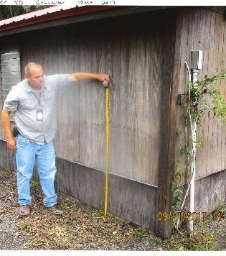
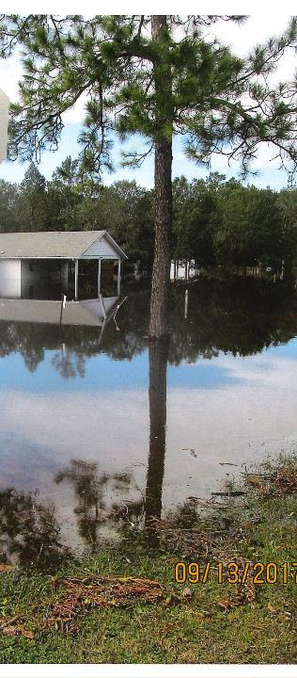
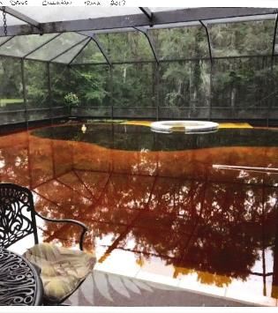
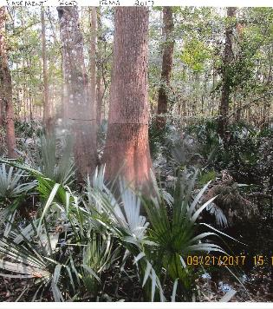
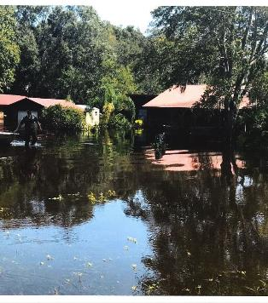
Hurricane Irma 2017: Thomas Creek
Notes:
Implements WNHP
Get ahead of development

Slide 19
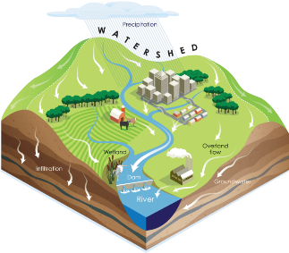
Engineering Efforts
Construction Inspector Reviewed site
Memo created or internal tracking
Suggestions documented
Resolution documented
KMZ file of known local flooding

Slide 20
Engineering: What Next
Ranking system for project-
Data for studies
Rain gauges
Marks on bridges
Models- PAS with the Army Corps
Stormwater Standard Guidelines
Updating Development Review checklist
Updating Pre-construction Forms
Stormwater Utility Fee
More changes to Stormwater Section
Review committee

