Slide 1
Water Quality Regulation in Georgia
J. Scott Pippin
St Marys River Management Committee
March 1, 2021

Slide 2
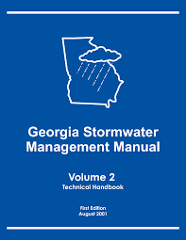
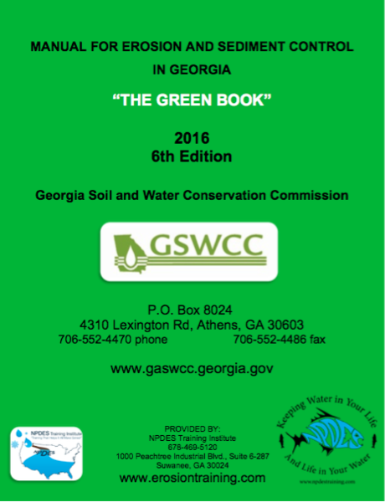
On the Ground Application
The “Blue Book” – Georgia Stormwater Management Manual (GSMM) and its Coastal Supplement.
The “Green Book” – Manual for Erosion and Sedimentation Control in Georgia.
Basis of Regulations for:
Stormwater Management
Stream Buffers
Septic System Siting

Slide 3
Major legislation:
Federal:
Clean Water Act (CWA) – regulates discharges of pollutants to water bodies.
Georgia:
Water Quality Control Act – state law enforcement of the CWA.
Erosion and Sedimentation Act – state law regulating land disturbing activities.
Georgia Planning Act – directs local governments to protect major river corridors.

Slide 4
Clean Water Act (33 U.S.C. 1251 et seq.)
Originally enacted in 1948.
Modern version passed in 1972
Goal “restore and maintain the chemical, physical, and biological integrity of the Nation’s waters.”
Based on the concept of “cooperative federalism” – shared powers between the federal gov’t and the states.

Slide 5
Clean Water Act
Section 402: requires that anyone who discharges a pollutant to the waters of the United States from a point source must obtain a permit.

Slide 6
Clean Water Act
Section 402: requires that anyone who discharges a pollutant to the waters of the United States from a point source must obtain a permit.

Slide 7
Clean Water Act
Section 402 establishes the –
National Pollution Discharge Elimination System (NPDES) Permit
Covers “point source discharges.”

Slide 8
Clean Water Act
NPDES Permitting authority is delegated to the states, with a few exceptions.
In Georgia, this is handled by the Environmental Protection Division (EPD) of Georgia DNR.

Slide 9
Clean Water Act
Section 404: prohibits the “filling” of waters of the United States.
“Filling” essentially means the discharge of dirt, sediment, or other fill material.
Covers wetlands.
Administered by the U.S. Army Corps of Engineers – not delegated to the states.

Slide 10
Clean Water Act
Non-point sources are not directly regulated.
States directed to develop Water Quality Standards.
States are required to report waters that do not meet these standards (known as the “303d/305b list”).
Provides funding to address causes of these impairments (Section 319 grants.
Limits NPDES permits that can be issued on impaired waters.

Slide 11
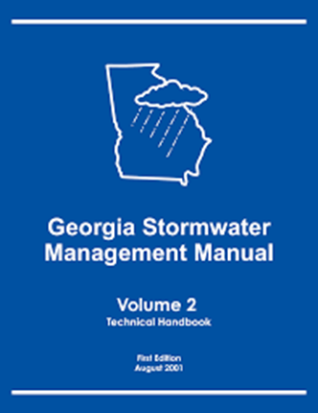
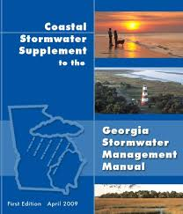
Clean Water Act
Stormwater initially classified as a non-point source and exempted from permitting.
1987 Amendments to the CWA created the Municipal Separate Storm Sewer System (MS4) Permit.

Slide 12
Clean Water Act
MS4 Permittees are required to adopt the GSMM.
Coastal communities are al
Along with other best-management and reporting practices.

Slide 13
Georgia Erosion and Sedimentation Act
State statute.
Regulates land disturbing activities that impact more than 1 acre.
Exempted or partially exempted:
Agriculture,
Forestry,
Surface mining,
DOT projects, and
public water system reservoirs.

Slide 14
Georgia Erosion and Sedimentation Act
Also mandates state level riparian buffers:
25 feet on state waters with wrested vegetation,
25 feet on coastal marshes, and
50 feet on trout stream.
Sets minimum standards. Does not preclude local government from enacting more strict requirements.

Slide 15
Georgia Erosion and Sedimentation Act
Enforced by Georgia EPD.
Enforcement often delegated to local governments as Local Issuing Authorities (LIA).
LIA must show:
Adopted local ordinances for land disturbing activities,
Have the ability to enforce such ordinances, and
Qualified personnel to monitor and enforce permits.

Slide 16
Georgia Planning Act
Directs local governments to adopt River Corridor Protection Plans.
Plans should protect 100’ buffers along rivers with a flow of 400 cfs.
Sets minimum standards including prohibiting septic systems (tanks serving a single family dwelling is allowed).
Plans adopted and enforced locally.

Slide 17
Questions?
Thoughts?
Comments?
Scott Pippin
jspippin@uga.edu
706 542-3250

