Slide 1
Resiliency Implementation Workplan
The Nature Conservancy;
University of Georgia;
Goodwin Mills & Cawood, Inc.
Camden County, Kingsland, St. Marys, and Woodbine.
NSB Kings Bay
Funded by The National Fish and Wildlife Foundation (NFWF)

Slide 2
Developing a Resiliency Implementation Workplan for Camden County (GA)
The Carl Vinson Institute of Government is a partner with Camden County, the City of St. Marys, City of Kingsland, City of Woodbine, The Nature Conservancy, Naval Submarine Base Kings Bay, Southeast Regional Partnership for Planning and Sustainability (SERPPAS), and the Georgia Sentinel Landscape Partnership to develop a Resiliency Implementation Workplan for Camden County via a stakeholder-driven planning process that results in actionable steps to assist local, county, and navy decision-makers in improving local resilience. The project will prioritize nature-based solutions by identifying and developing opportunities for nature-based, green-grey infrastructure projects to mitigate flooding, storm surge, sea-level rise risks, and other threats to local infrastructure and facilities.

Slide 3
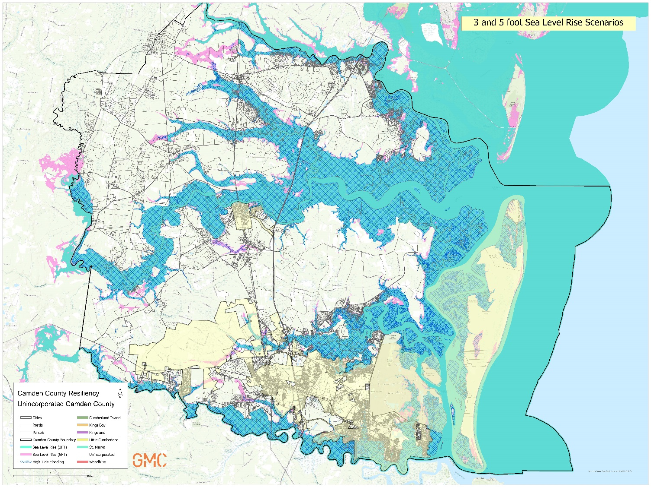
Resiliency Implementation Workplan
Primarily focused on Flooding and Coastal Erosion
Caused by:
Sea Level Rise (tidal flooding)
Storm Surge Flooding
Stormwater and
Riverine Flooding

Slide 4
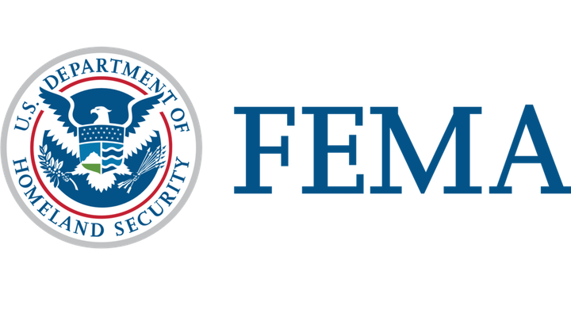
Connect to Future Funding Opportunities
Building Resilient Infrastructure and Communities (BRIC)

Slide 5
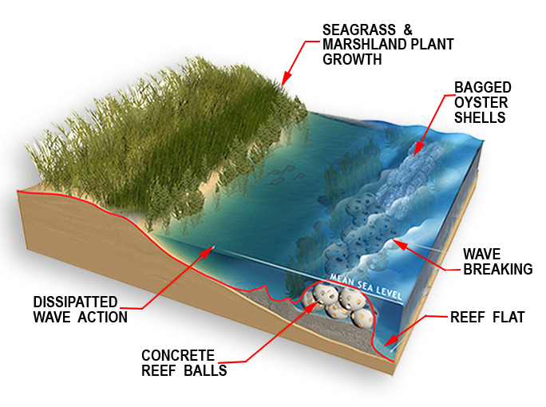
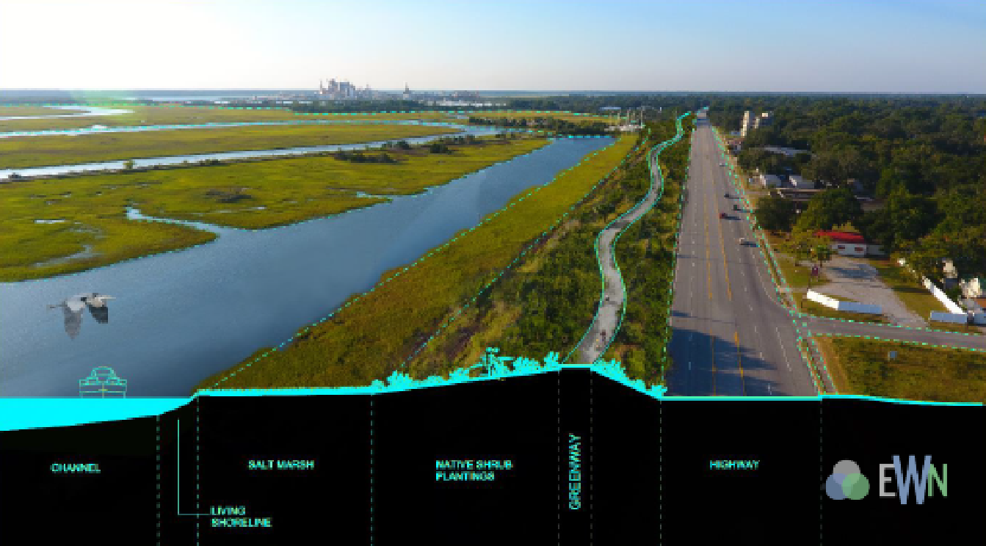
Resiliency Implementation Workplan
Prioritizing Natural Infrastructure Solutions

Slide 6
Planning Process
Plans Review
Community Engagement
Steering Committee of project partners
Stakeholder Interviews & Focus Groups
Community Survey
Townhall-style Public Meeting
Report Compilation
Seeking Funding for Implementation

Slide 7
Community Survey
Camden County Resilience Implementation Workplan (arcgis.com)

Slide 8
Questions? Comments? Thoughts?
Interested in participating in an interview or focus group?
Scott Pippin
jspippin@uga.edu
Ashby Worley
ashby.worley@TNC.ORG

Slide 10
CONNECT WITH US

