Slide 1
St. Mary’s River Committee – Nassau and Baker County Septic Program
Florida Department of Health
in Nassau County

Slide 2
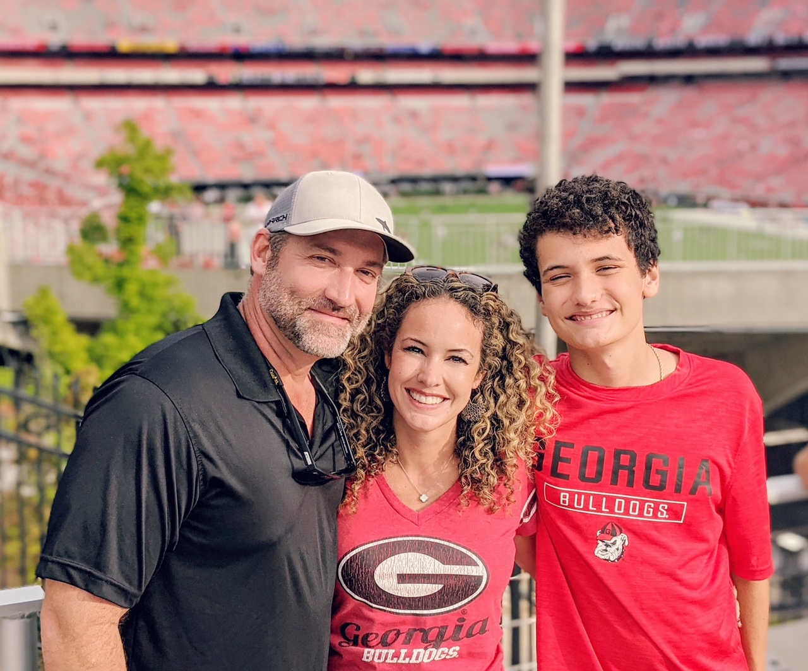
Presenter
Michael Godwin
Environmental Health Manager
Florida Department of Health in Nassau and Baker County

Slide 3
Questions Being Addressed:
How does Nassau and Baker County Environmental Health Departments work to ensure septic runoff doesn’t reach surface waters
Permit/Inspection process

Slide 4
Questions Being Addressed:
2. How do we identify illegally or improper installed septic tanks
Complaint Notification Process

Slide 5
Questions Being Addressed:
3. How does Environmental Health educate the community for adequate maintenance of septic systems?
Website
Social Media
Brochure/pamphlets

Slide 6
Questions Being Addressed:
4. How is runoff prevented from multi-home developments?
Development Review Committee (DRC)

Slide 7
Questions Being Addressed:
Transfer update for OSTDS Program from DOH to DEP
Effective July 1, 2021

Slide 8
Contact Information:
Michael Godwin
Environmental Health Manager
Florida Department of Health in Nassau and Baker County
Michael.Godwin@flhealth.gov
904-557-9150

