Slide 1
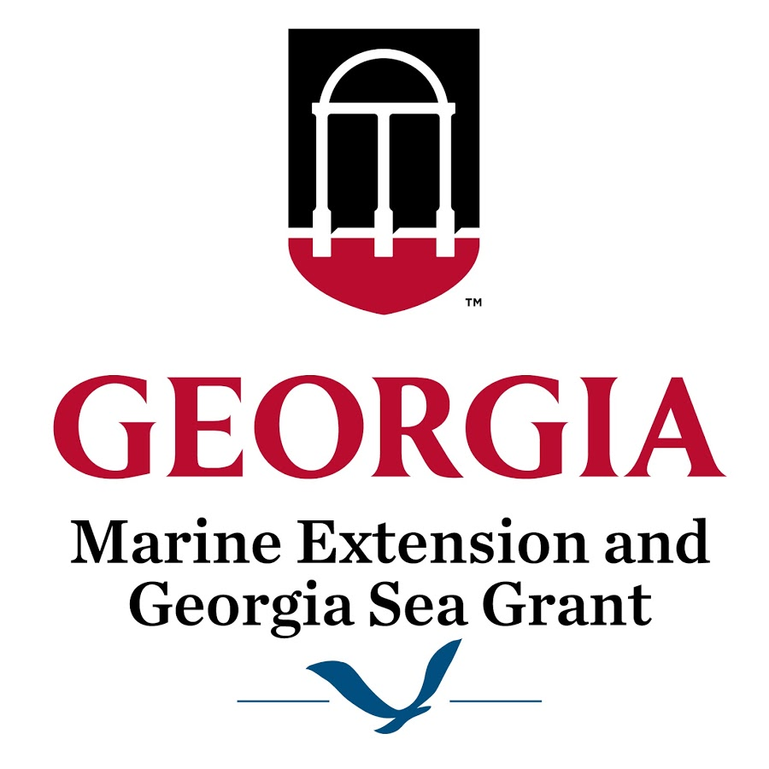
Coastal Septic Mapping Rationale, Methods, & Applications
Courtney Balling, PhD Student
Integrative Conservation & Geography
Marine Extension & GA Sea Grant

Slide 2
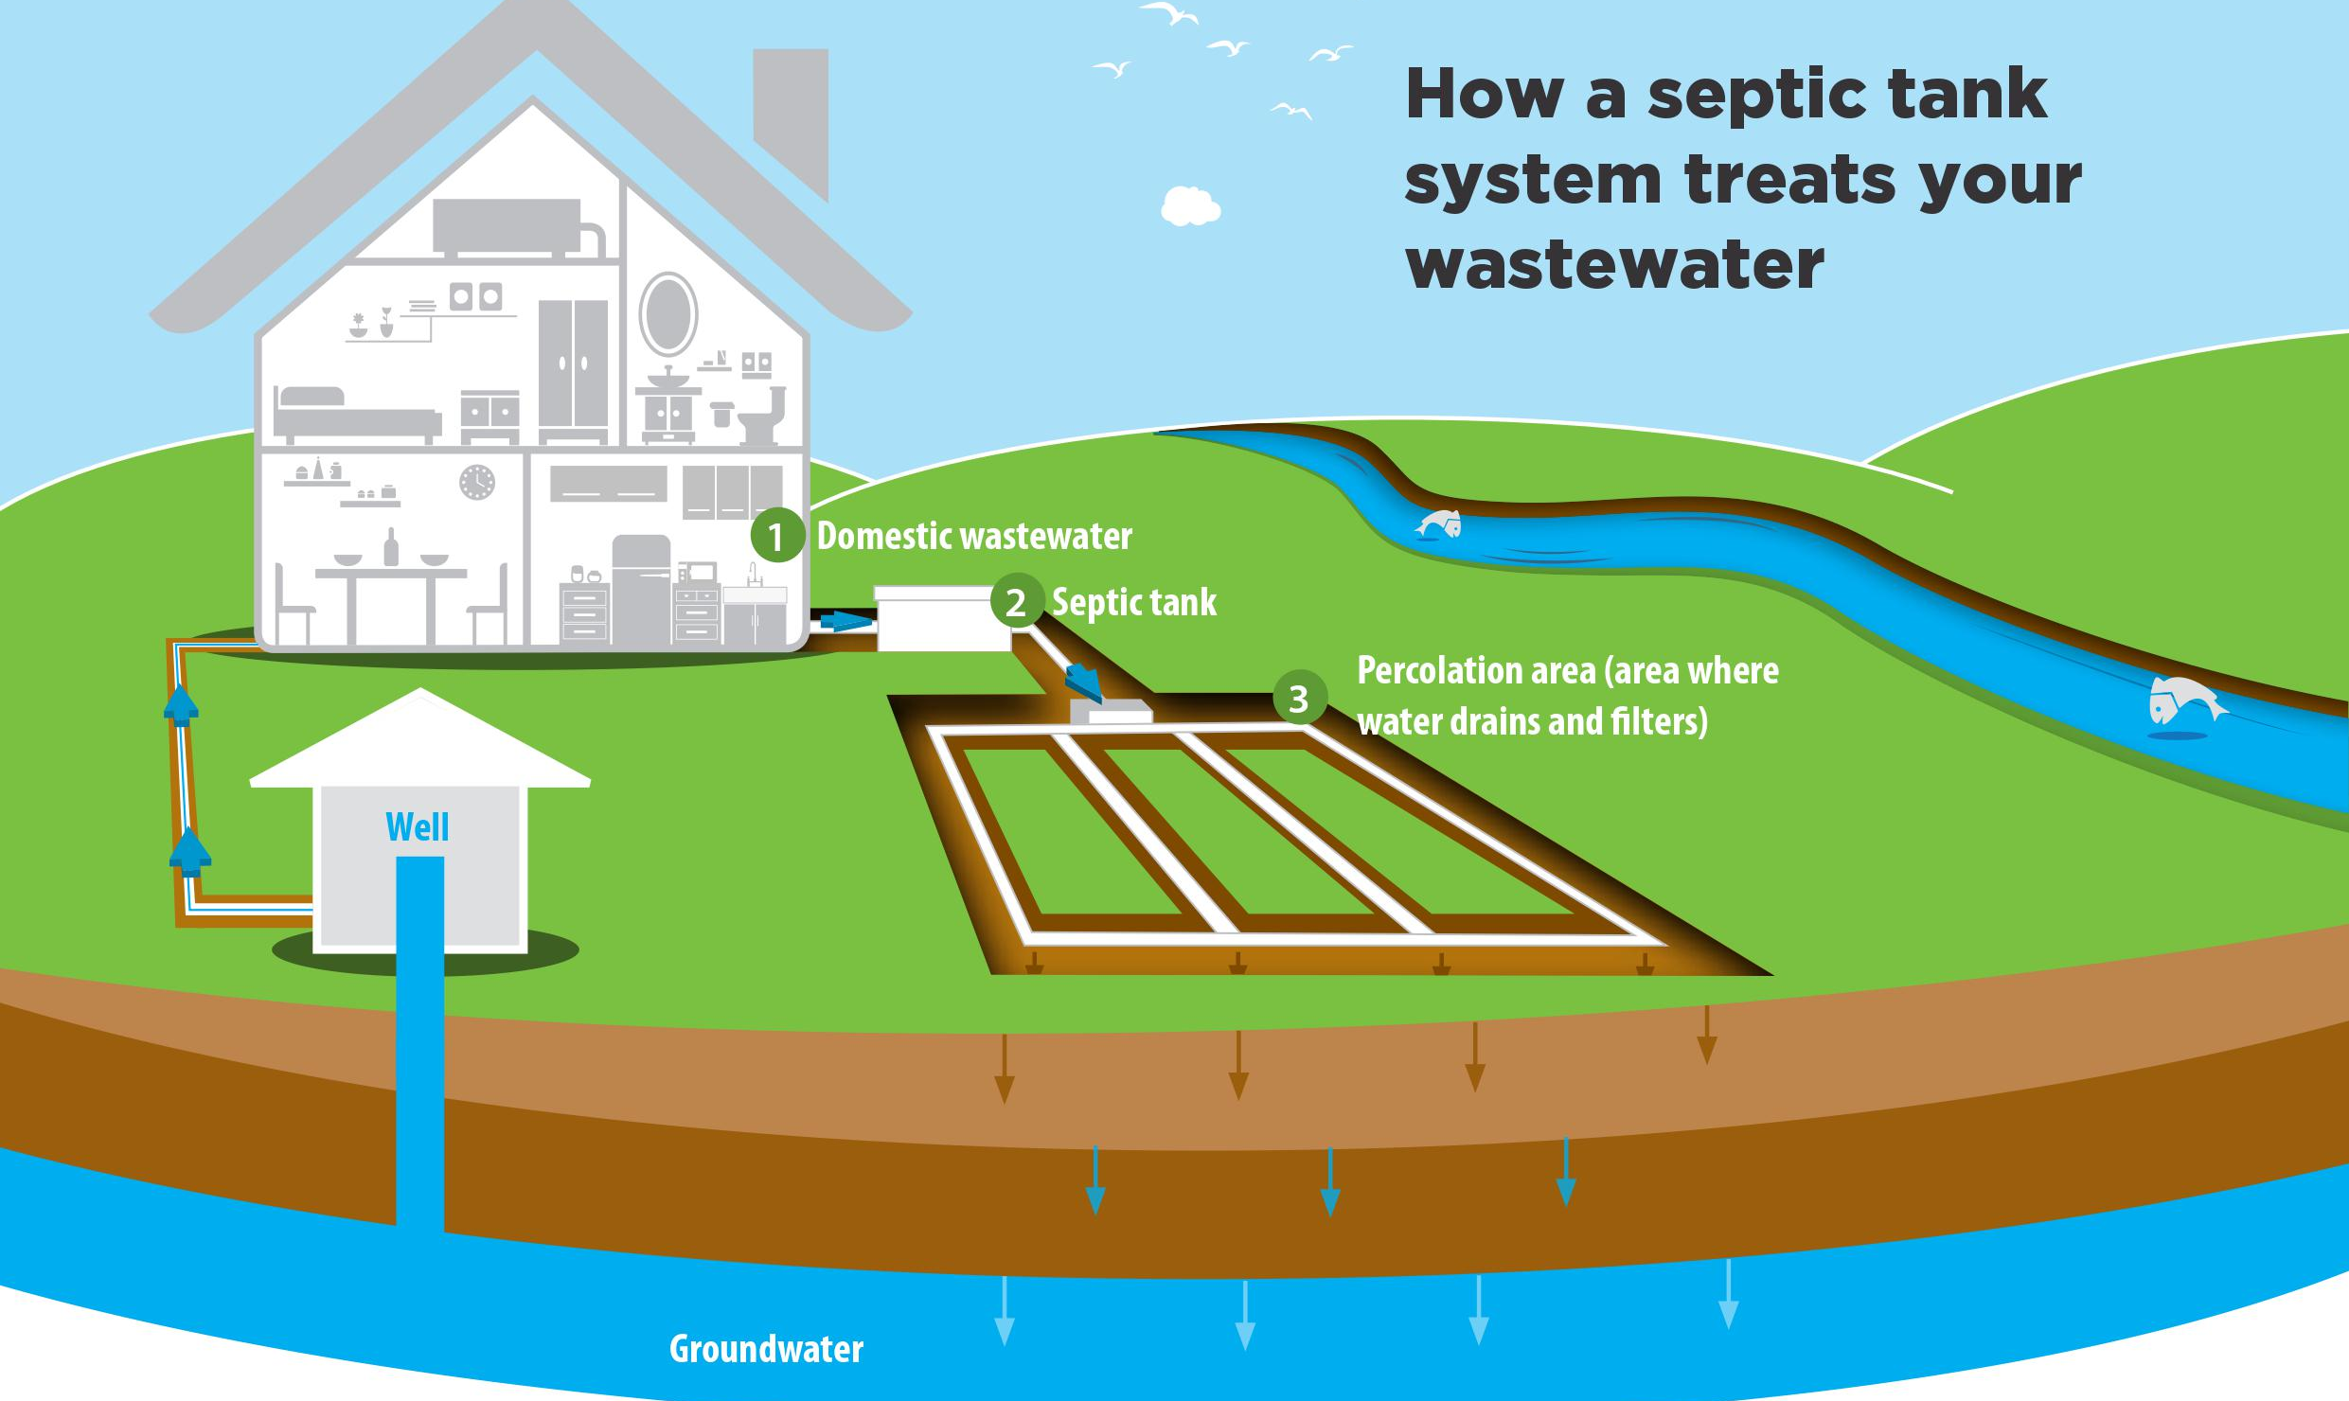
Project Rationale
More than 60 million people in the US are served by septic systems (EPA, 2019)
One third of new development is served by septic (EPA, 2019)
O’Reilly Oaks Environmental
Notes:
Let’s start with what a septic system is and how it works.
Wastewater filters to groundwater, which then flows to surface water or may be extracted from a well.
*animate*
Just as river levels and groundwater levels are correlated (example: baseflow), so are sea levels and groundwater levels in coastal areas. It’s all connected.
So why does this matter?
*animate*
Well, coastal areas often have naturally high water tables because they’re low lying, and as sea levels rise, those groundwater levels will rise even more.

Slide 3
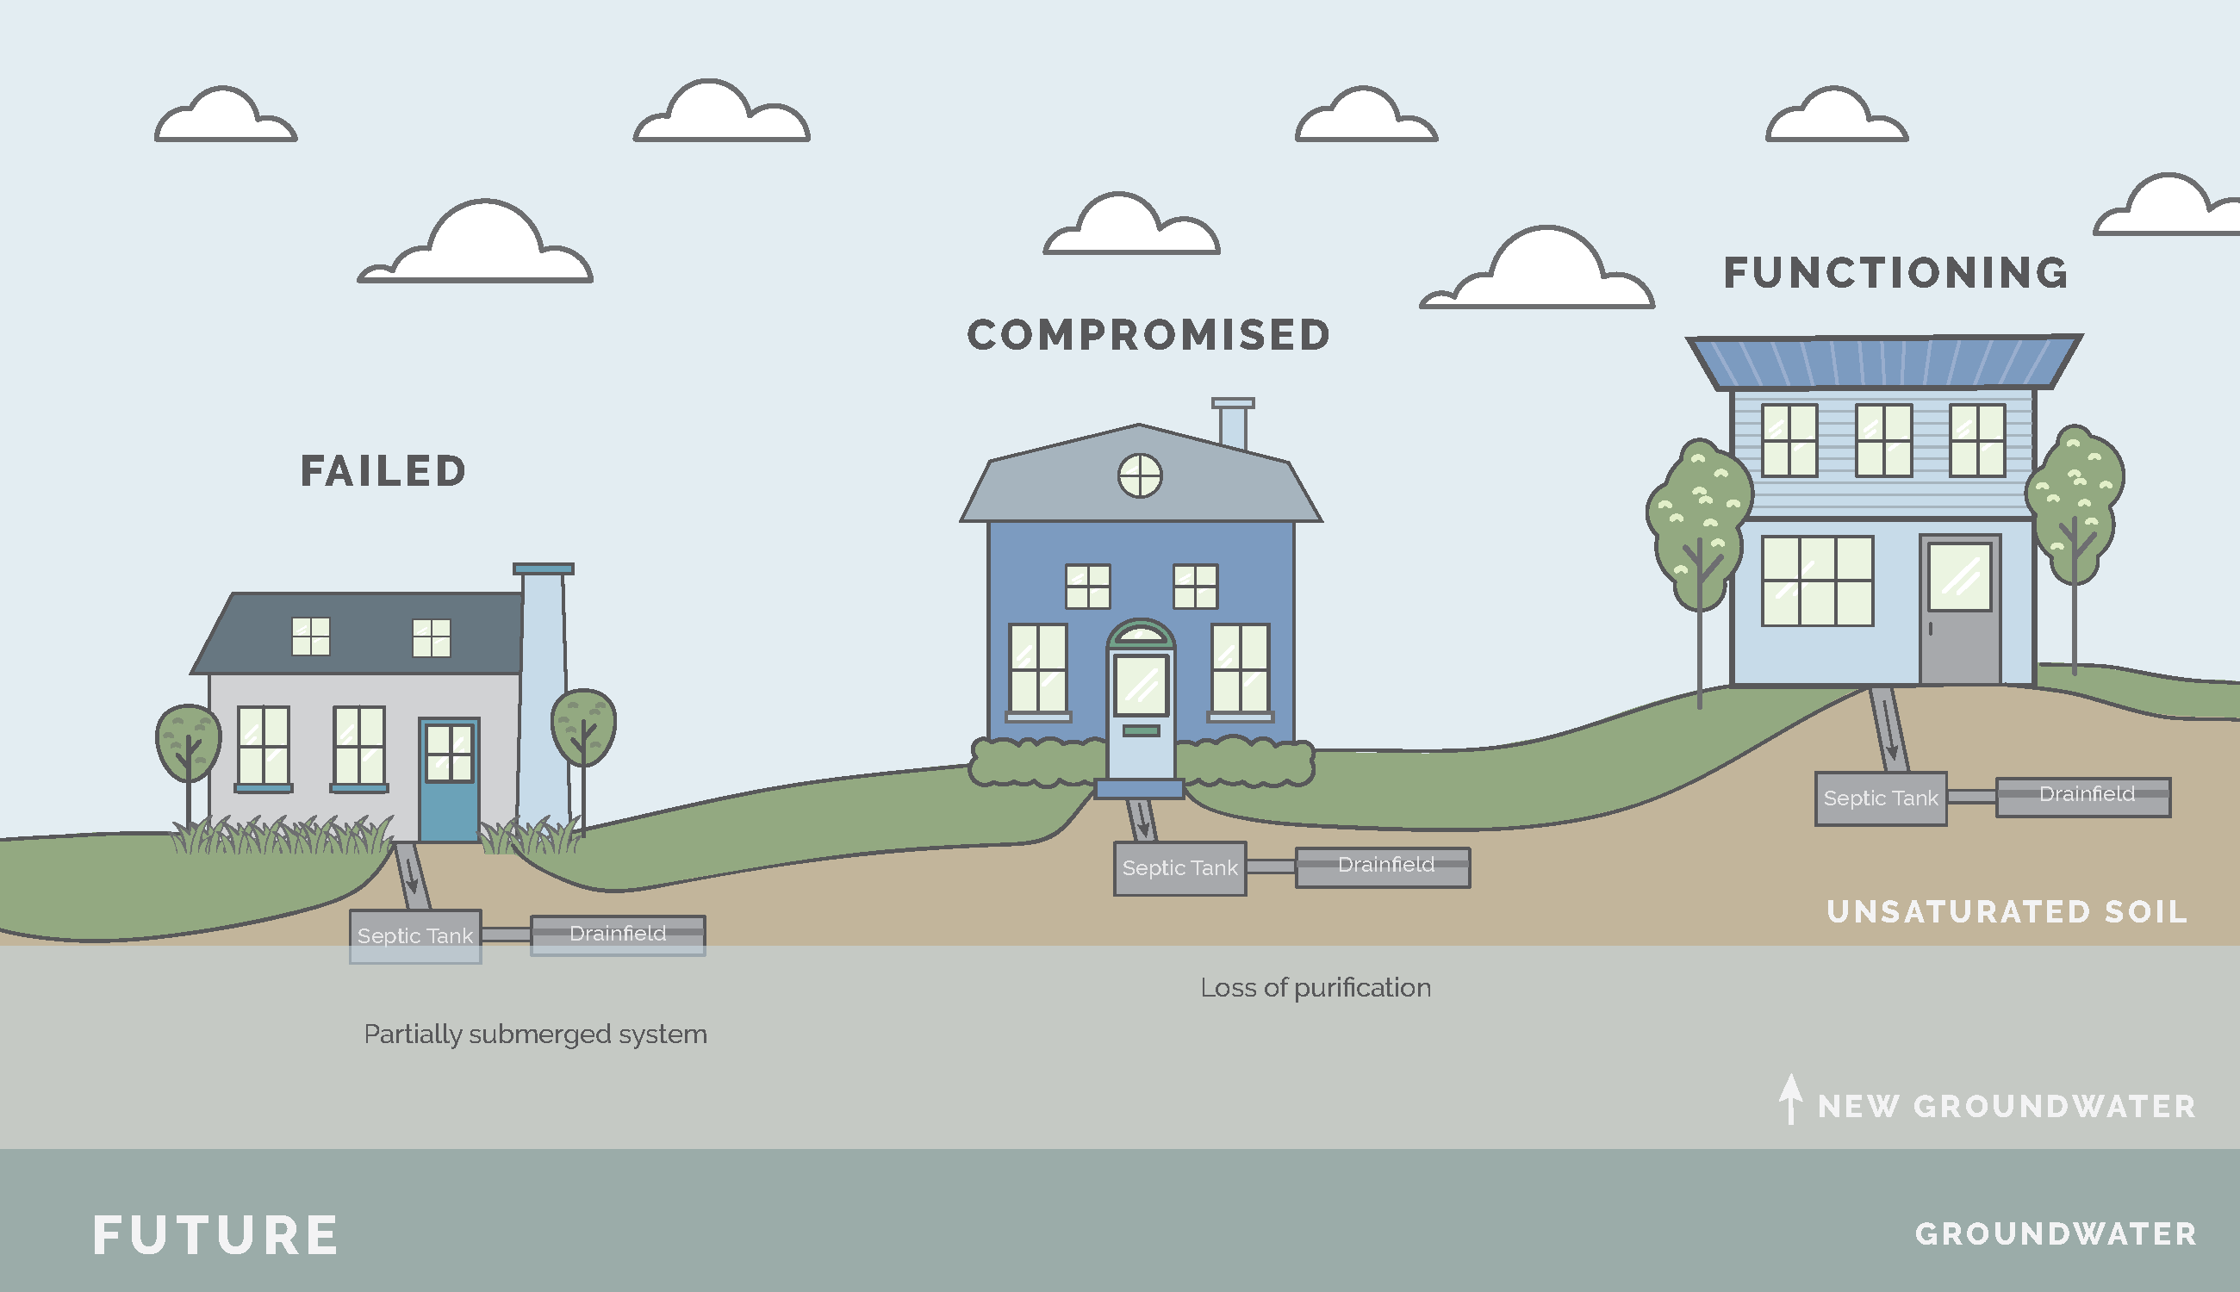
Project Rationale
Carl Vinson Institute
Notes:
Let’s start with what a septic system is and how it works.
Wastewater filters to groundwater, which then flows to surface water or may be extracted from a well.
*animate*
Just as river levels and groundwater levels are correlated (example: baseflow), so are sea levels and groundwater levels in coastal areas. It’s all connected.
So why does this matter?
*animate*
Well, coastal areas often have naturally high water tables because they’re low lying, and as sea levels rise, those groundwater levels will rise even more.

Slide 4
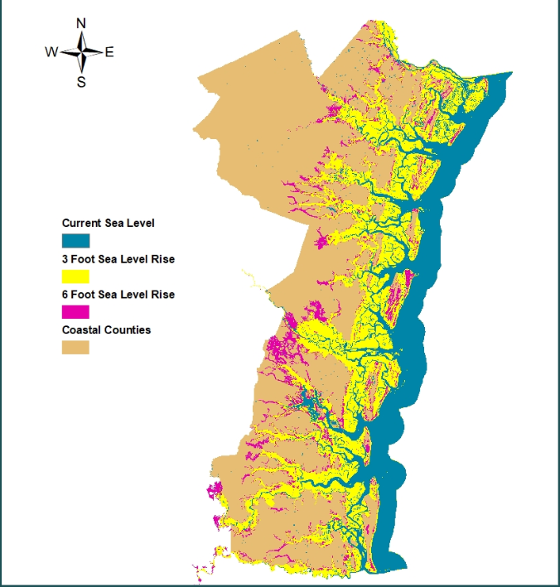
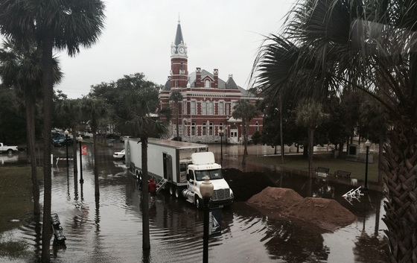
Local Sea Level Rise Projections
0.9-1.8 meters (3-6 feet) of rise predicted in GA by 2100 (Hauer, Evans, & Alexander, 2015)
Seasonal high tides already creating “nuisance” flooding
NOAA, 2019

Slide 5
Funded through DNR-CRD Coastal Incentive Grants Ongoing effort since 2009
Project History
Counties mapped
Camden
Glynn
Mcintosh
Liberty
Bryan
Chatham
Effingham
Wayne
Counties in progress
Brantley*
Charlton*
*will be finished by September 2021

Slide 6
Methodology
All septic records pre-2009 are paper copies only
Historic septic records are identified by PIN, address, or owner
Older records are difficult to locate
Information from paper records is entered into Digital Health Department and mapped
Includes system age and size, depth to groundwater, etc.
Welstrom.com/Coastal updates from Digital Health Department every 24 hours

Slide 7
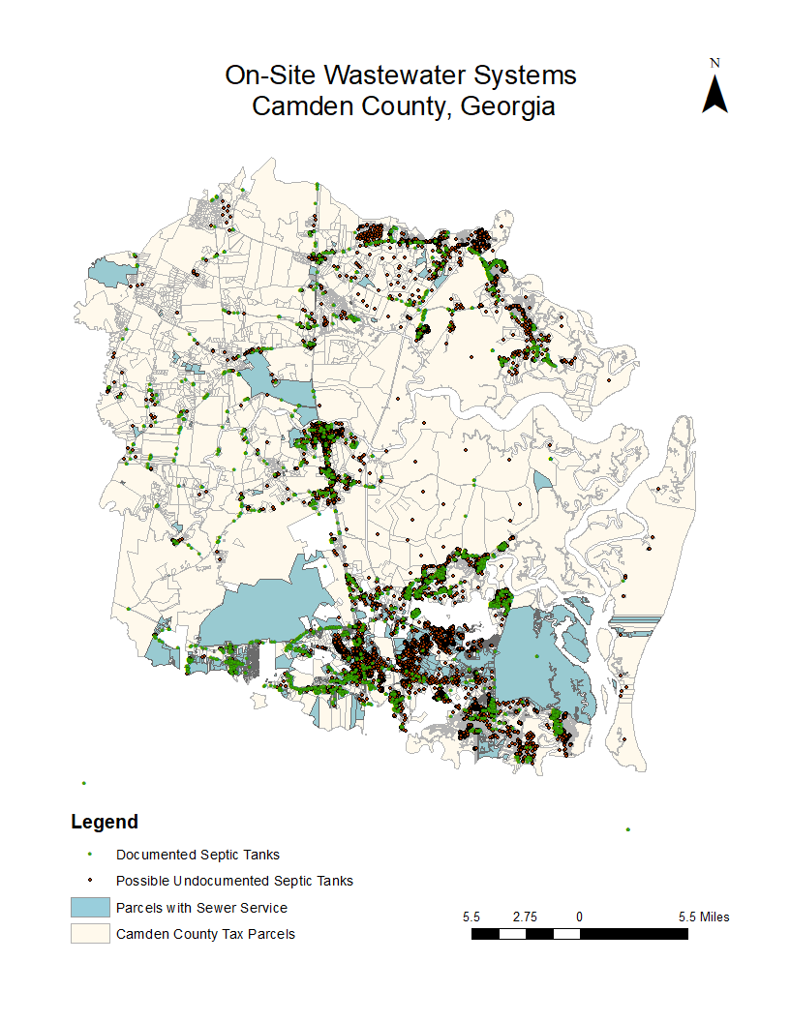
Camden County Results
4,129 documented septic systems
6,599 possible undocumented septic systems
Does NOT mean that all systems are unpermitted
Each county has a significant number of permits that could not be located

Slide 8
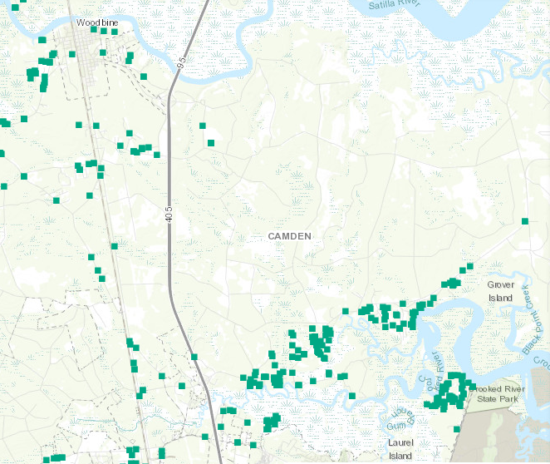
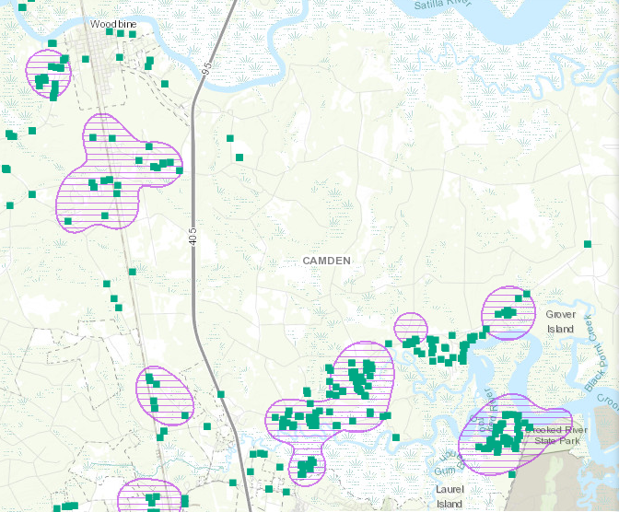
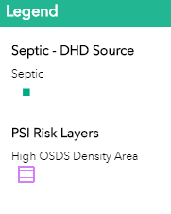
Applications
Targeted Monitoring of High density septic sites
Welstrom.com/Coastal

Slide 9
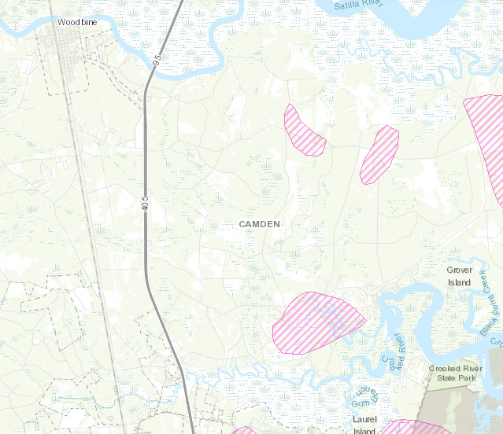
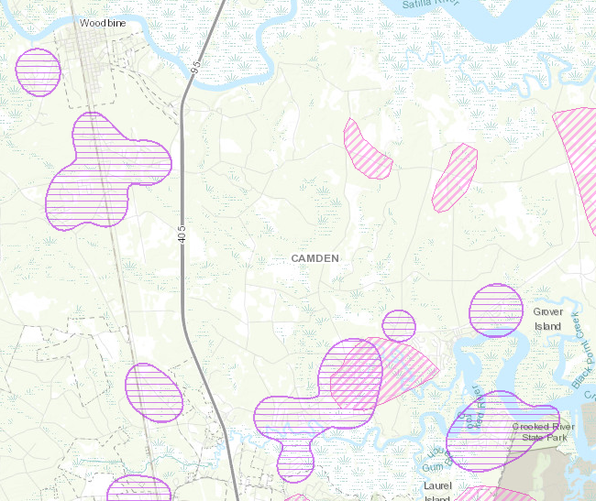
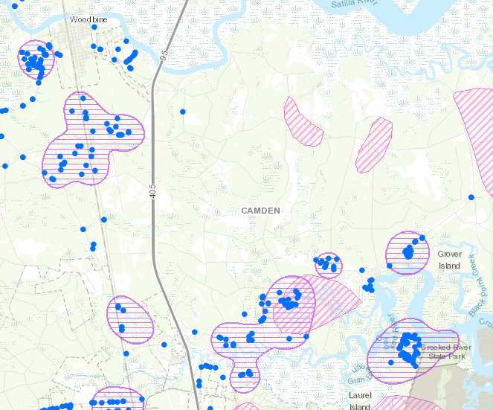
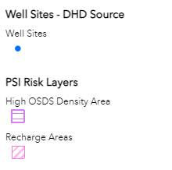
Groundwater Quality & Public Health
Applications
Welstrom.com/Coastal
Notes:
These are areas to be mindful of septic tank failures

Slide 10
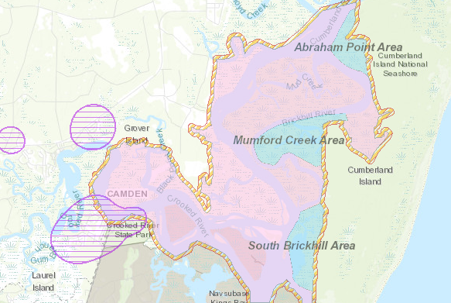
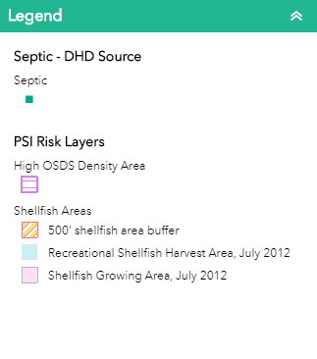
Healthy Fisheries
Applications
Welstrom.com/Coastal

Slide 11
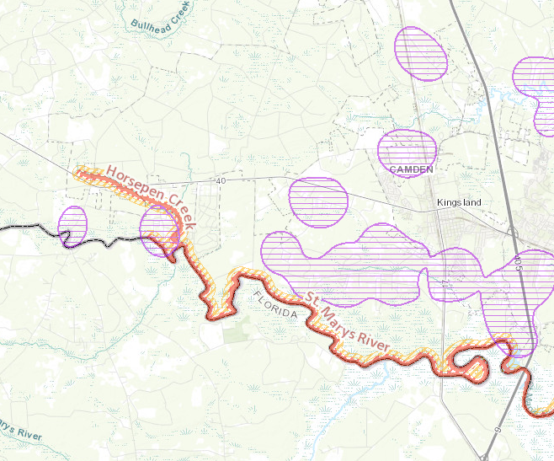
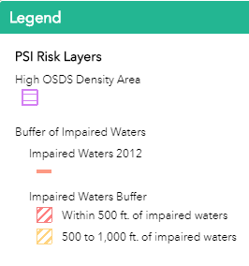
State & Federal Funding
Applications
Welstrom.com/Coastal

Slide 12
Thank You! Contact: Courtney.Balling25@uga.edu Visit Welstrom.com/Coastal

